Slide 1
Elastic Stack
February 2018

Slide 2
Overview
09:00 – 11:00
Classroom PC and Azure server setup (https://portal.azure.com)
Elastic stack overview (https://www.elastic.co/)
Elasticsearch CRUD session (github.com/KarlMSola/elastic-demo)
Data import and enrichment with Logstash, Beats, ES-Hadoop, Kafka
12:00 – 15:00
Practise importing datasets - Demonstrate importing the movie database (awesome-json-datasets) - Do yourself: “Varsel om feil” (Stavanger Kommune)
Techniques and process for creating visualisations, how to find hidden treasures, etc.
How to transfer our new knowledge to our enterprise production datalake

Slide 3
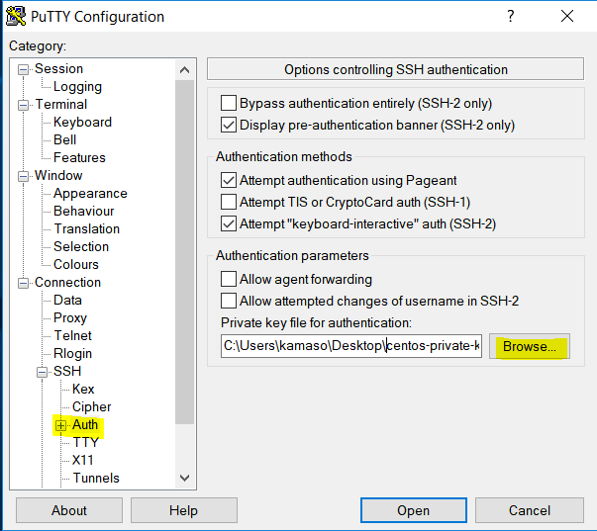
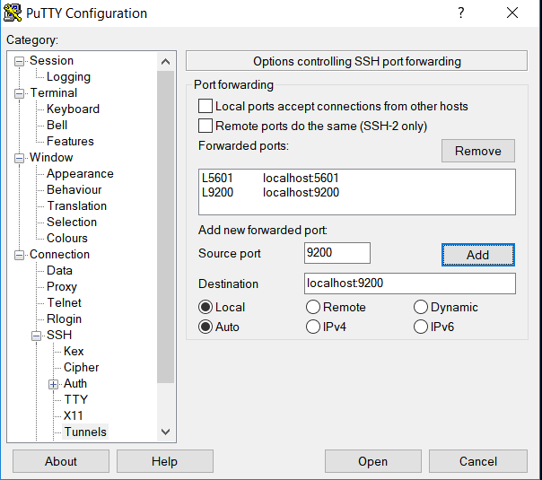
Classroom PC setup
Install putty.exe on your classroom computer
Set up SSH Auth with the common private key (copy from the OneDrive link provided)
Set up tunneling for localhost:9200 and localhost:5601
Add our corporate proxy, type HTTP: <...>
Identify the public IP addess of your Azure lab server, («st-<username>») in https://portal.azure.com
Log onto your server. E.g.: centos@52.138.223.192 Note: The passphrase for the ssh key is: <…………..>
If everything went well, you should be able to point your browser to localhost:5601 and log on with the default credentials:elastic/changeme

Slide 4
Elasticsearch CRUD interactive session
If everything went well, you should be able log on with the default username elastic and password changeme http://localhost:5601
The rest of this session is interactive, following the script.txt here: https://github.com/KarlMSola/elastic-demo

Slide 5
Open dataset: “Varsel om feil”
Install logstash-*.tgz from elastic.co download (link)
Get aquainted with the data and what they look like (link)
Build logstash.conf and import data set Cheat sheet for all commands required are here: azure-setup-and-lab-cheat-sheet.txt (line 155)
Once data is imported, go to Kibana, localhost:5601
Define a new index pattern “logstash-vof”
Create elements for visualizing the data.
Try and answer question like:
What is the most common errors reported?
Which streets have unusually high rat problems? (tip: significant search)

